Slide 1
UI Storyboard

Slide 2
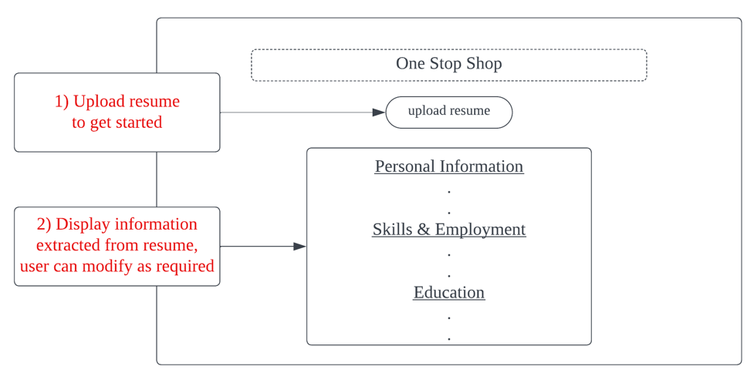
Main page

Slide 3
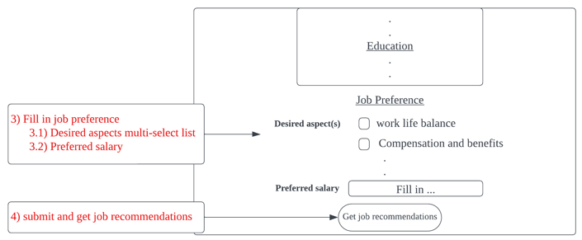
Main page

Slide 4
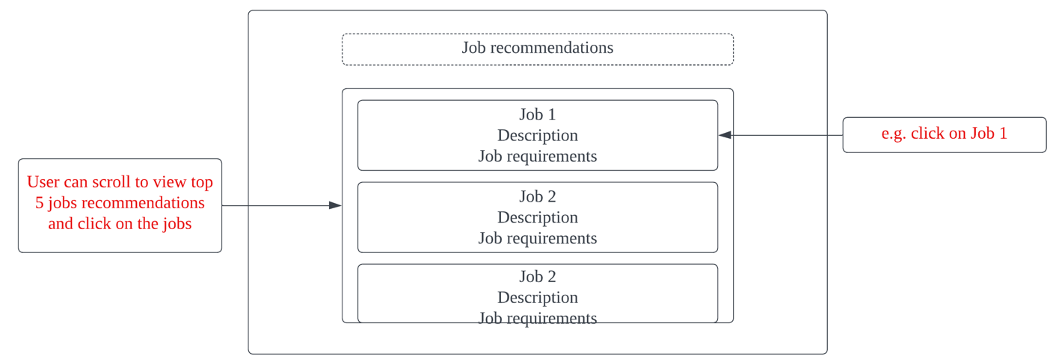
Job recommendation page
Back button
Learning page

Slide 5
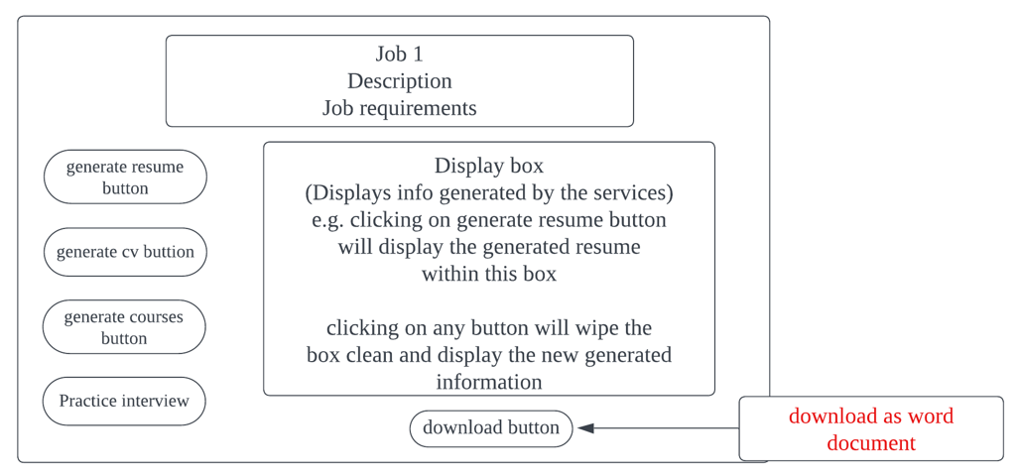
Learning page

Slide 6
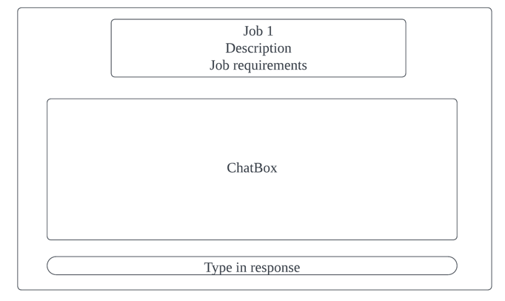
Interview chatbot page

Slide 8
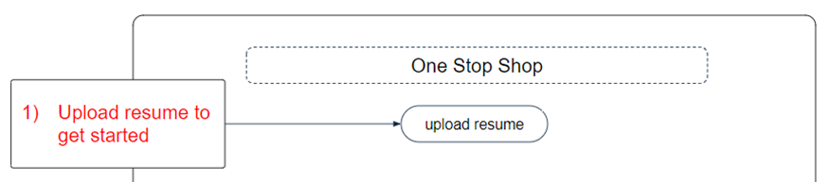
Main page

Slide 9
Main page
One Stop Shop
upload resume
2) Display information extracted from resume. User is able to edit as required
Personal Information
Work Experience
Education
3) Click on Submit once everything is correct
Submit

Slide 10
User Preference page
Job Preference
Job position
Desired location
4) User to key in or select job preferences
Desired Employment Type
Desired Seniority Level
Required Job Experience (no. of years)
Desired Aspect(s)
Minimum Salary
5) Click on submit after filling in the job preferences
Submit

Slide 11
User Preference page
Job Preference
Job position
Desired location
Desired Employment Type
Desired Seniority Level
Required Job Experience (no. of years)
Desired Aspect(s)
Minimum Salary
Submit
6) Click on one of the jobs to proceed
Job 1
..
Job 5

Slide 12
Cover Letter Generator, Resume Generator, Learning Resources page
7) Click on cover letter generator to generate and download cover letter
Career Learning Hub
Cover Letter Generator
8) Click on resume generator to generate and download resume
Resume Generator
Learning Resources
9) Click on learning resource generator to generate and download learning resource document
Ready to start practicing for your interview?
I am ready!
10) Click on “I am ready!” button to start mock interview with behavioural interview chatbot

Slide 13
Behavioural Interview Chatbot page
Interview Chatbot
List of possible behavioural interview questions
11) User to fill in possible reply to the interview questions
Current response
Submit
12) Click on the submit button to receive feedback from the chatbot
Past responses and feedback from chatbot

